Slide 1
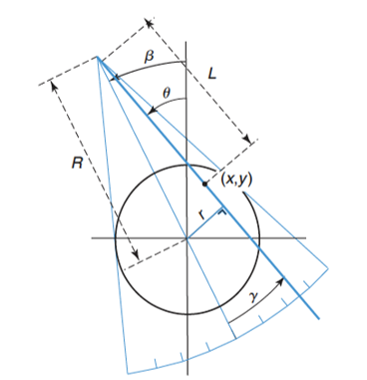
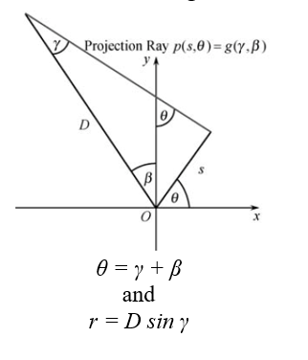
Principle of fan beam CT

Slide 2
Rebinning
p (r, θ) = g (γ, β)
r = x cos θ + y sin θ; s= - x sin θ + y cos θ
x = r cos θ - s sin θ; y = r sin θ + s cos θ
x=R cos ϕ; y=R sin ϕ;
p(r, θ) = ∫∫ δ(R, ϕ) δ(x cos θ+y sin θ- r) dx dy
r = R cos(θ -ϕ)
Applying the above rebinning conditions for fan beam CT,
g(D sin γ, γ +β) = ∫∫ δ(R, ϕ) δ(x cos (γ +β) +y sin (γ +β )- D sin γ) dx dy
r = R cos(γ + β -ϕ)

Slide 3
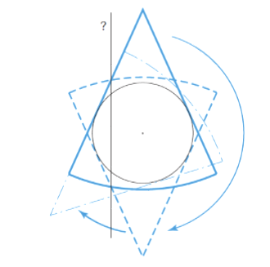
360 Degree Acquisition

Slide 4
Filtered back projection
b(x,y)= f(x,y) ⊗ 1/√x2 +y2
B(ωx, ωy)= F(ωx, ωy) ⊗ 1/√ωx² +ωy²
F(ω_{x}, ω_{y})= B(ω_{x}, ω_{y})⊗ |ω|
f(x,y)= IF[F(ω_{x}, ω_{y})]= IF[B(ω_{x}, ω_{y})⊗ |ω|]

Slide 5
Computing fanbeam projection data
Arguments of fanbeam function:
- Image
- Distance between vertex and centre of rotation
- FanSensorGeometry (arc-default,line)
- FanSensorSpacing(angle/distance between sensors)
-FanRotationIncrement(fan rotation angle increment)

Slide 6
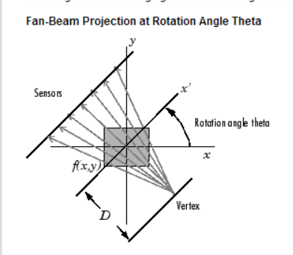
FAN BEAM IMAGE RECONSTRUCTION
‘fanbeam’ function computes line integrals along path radiate from single source
Multiple projections rotating source around the centre of image

Slide 7
Reconstruction of Image
Use ‘ifanbeam’ function
Arguments of ifanbeam:
-Projection Data
- Distance between vertex and centre of rotation
The ifanbeam function converts fan-beam projection data to parallel beam projection data with the fan2para function and calls iradon function to perform image construction.

Slide 8

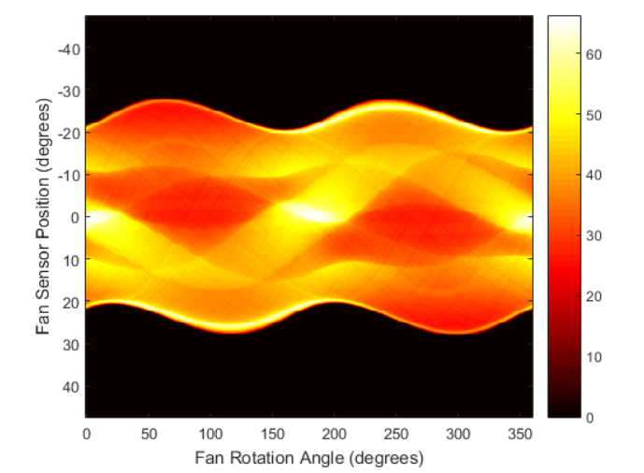
Example
[
P=phantom(256);
D=250;dsensor1=0.25
[F3, sensor_pos3, fan_rot_angles3] = fanbeam(P,D,... 'FanSensorSpacing',dsensor1);

Slide 9

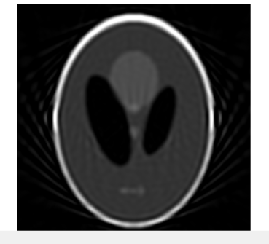
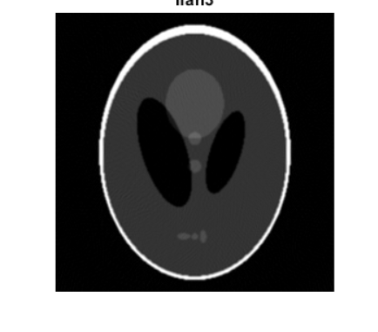
output_sizmax(size(P));
Ifan1 = ifanbeam(F1,D, ...
'FanSensorSpacing',dsensor1,'OutputSize',output_size);
Sensor spacing=2
Sensor spacing=1
Sensor spacing=0.25

Slide 10
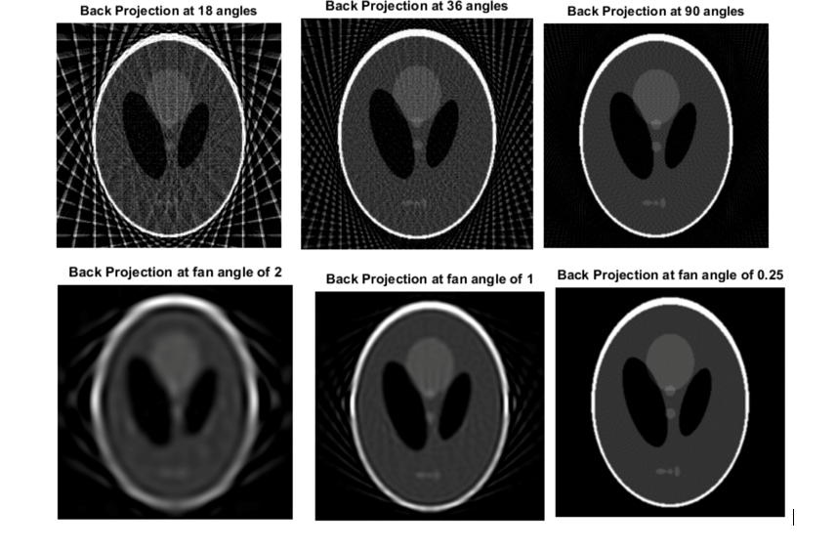
Comparison of radon and fanbeam

